Slide 1
Capstone Project
Employee Review of Comment Analysis

Slide 2

Business Objectives
Basic Exploratory Analysis on different metrics available to get insights on Rating basis
To analysis the various factors connected to the Employer with Employees Relationship and improve on those parameters viz overall_ratings, Last work_balance_stars, culture_values_stars, carrer_opportunities_stars etc.
Technology-wise Objective : Creating an End-to-End Pipeline to enhance the automation to do quick analysis and manage all the repetitive actions in a proper-structured manner.

Slide 3
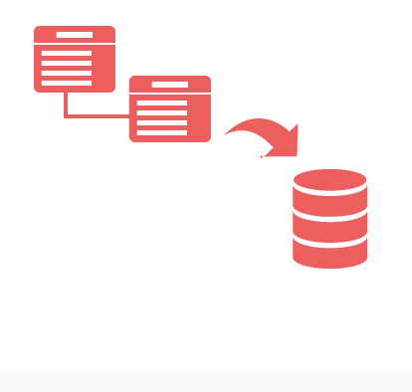
Data Description
There are OneTable(Records) :-
1. emp_reviews

Slide 4

Data Description
Table:emp_reviews.csv
Sno integer Not Null
Company STRING Not Null
Location STRING Not Null
Dates STRING Not Null
job_title STRING Not Null
Summary STRING Not Null
Pros STRING Not Null
Cons STRING Not Null
overall_ratings integer Not Null
work_balance_stars integer Not Null
culture_values_stars integer Not Null
carrer_opportunities_stars integer Not Null
comp_benefit_stars integer Not Null
senior_mangemnet_stars integer Not Null

Slide 5









Technology Stack
Linux Commands (to run the bash script)
PostgreSQL(to create database - RDBMS)
Sqoop (Transfer data from PostgrSQL Server to HDFS/Hive)
HDFS (to store the data)
Hive (to create database)
SparkSQL & PySpark (to perform the EDA)
git (for version control)

Slide 6
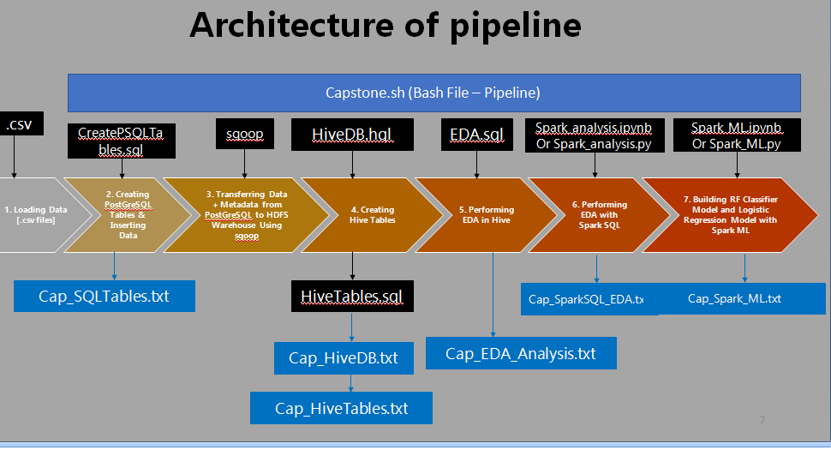

Slide 7

Challenges Faced
Importing the Data from Linux to Hive
Fetching the Hive tables in Spark (Jupyter Notebook Environment)

Slide 8

Inference
Modifying / Upgrading of Working Policies Focusing on the Employer-Employees Relationship.
Fixing the Issues related to the Appraisals / Ratings. so that probability of loosing a Rating can be reduced.
Using the current model further analysis can be done with newly updated employee Rating to understand employee sentiments.

Slide 9
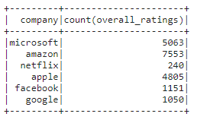
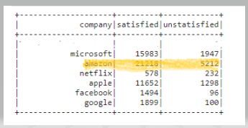
Amazon providing the good environment such as
Work-balance
Culture values
Career opportunities
Senior-management
for the employees having good employees employer relationship

